Slide 1
Deloitte SFL Presentation
By
Emmanuel Oyekanlu

Slide 2
Presentation Outline
Work Plan for the Implementation of ChemBERTa at BPC (slide 2 – slide 9)
PostgreSQL Based Data ETL Solution on Docker with pgAdmin and Streamlit Frontend (slide 10 – slide 15)
Deep Learning Model Deployment on Docker with Flask API (slide 16 – slide 19)
Questions/Suggestions

Slide 3
Work Plan for the Implementation of ChemBERTa at BPC
Background
Big Pharma Company (BPC) seeks to deploy ChemBERTa machine learning algorithm for its downstream applications.
Deploying ChemBERTa will enable BPC to do chemical fingerprinting , molecules representation and property prediction of BPC’s materials and products.
BPC have IT/Cloud team with no knowledge of AI/ML workloads
BPC have approached Deloitte-SFL team to implement the ChemBERTa algorithm and deploy it as part of BPCs downstream applications.
BPC needs a work plan from the Deloitte-SFL team

Slide 4
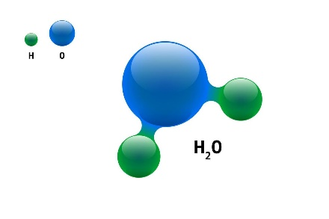

Work Plan for the Implementation of ChemBERTa at BPC
Background
Molecules exists with 3D geometries (biological, chemical & physical properties)
Big Data
Simplified Molecular Input Line Entry System (SMILES) data set.
World’s largest open source collections of chemical & molecular structures.
ChemBERTa algorithm based on RoBERTa algorithm was trained on the SMILES data set.
HuggingFace Open Source Machine Learning Libraries

Slide 5
Work Plan for the Implementation of ChemBERTa at BPC
Deliverables by Deloitte SFL Team
A ChemBERTa based ML model that can accomplish molecules property prediction using BPC’s data
Integration of the developed NLP model for downstream applications at BPC
Deployments through cloud APIs. Possibly desktop apps deployments. Based on needs.
Reliability of the deployed model will be accomplished by containerization and Kubernetes technologies.

Slide 6
Work Plan for the Implementation of ChemBERTa at BPC
Team & Resources
A ChemBERTa based ML model that can accomplish molecules property prediction using BPC’s data
Integration of the developed NLP model for downstream applications at BPC
Deployments through cloud APIs. Possibly desktop apps deployments. Based on needs.
Reliability of the deployed model will be accomplished by containerization and Kubernetes technologies.

Slide 7
Team & Resources Needed
DeloitteSFL Project Manager (Data Engineering / AI Applications)
Two (2) Data Engineers with knowledge of GPU, CUDA, RAPIDS (cuDF, Dask, cuxFilter), Vaex and/or OpenCL
Two (2) DeloitteSFL NLP Engineers with knowledge of HuggingFace suite of libraries.
DeloitteSFL Data Visualization Engineer with knowledge of rendering 2D and 3D interactive graphs. Plotly, Chemplot, Mayavi, PyVista, etc.
Two (2) molecules/chemical/materials engineers from BPC
Two (2) BPC Engineers. Data/ML engineers. BPC engineers that can be quickly trained can also fit in.
One (1) Software Engineer from DeloitteSFL
One (1) DevOps Engineer from DeloitteSFL

Slide 8
Time Estimates
Initial ETL/ELT activities
ChemBERTa model transfer learning using BPC’s data.
Possible retraining of RoBERTa from ground up to achieve a better
ChemBERTa model
Software & DevOps Engineer, dockerization, Kubernetes, cloud and
possibly desktop app deployments
Usage manual design, training of BPC material engineers with regards to
app usage
Time estimate is approximately 245 – 400 hours. Time estimates can be reviewed after further discussion with the entire team at Deloitte SFL and BPC
60 hours
80 hours
55 hours
50 hours

Slide 9
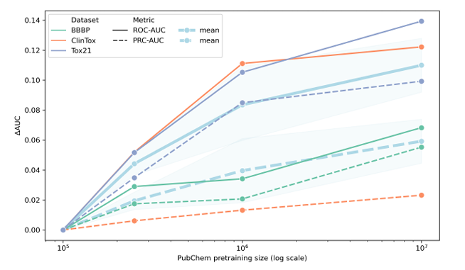
Success Criteria
Authors of ChemBERTa suggested using ROC/AUC curves to measure the performance of the ChemBERTa algorithm.
Apart from test data sets, performance can also be tested with known molecules to see if the model generalizes well.
Performance data can also be harvested over time from field reports by BPC users.

Slide 10
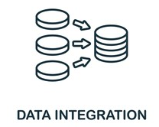
PostgreSQL Based Data ETL Solution on Docker with pgAdmin and Streamlit Frontend
Background
An Extraction, Transform and Loading (ETL) project that automates the ingestion of data from a provided CSV/xlsx file, transform the data and load the data into a PostgreSQL database.
Result
Loaded data can be viewed through using PostgreSQL’s pgAdmin user interface (UI).
Streamlit (front end) for user’s convenience.
Docker & virtual environment for reproducibility

Slide 11
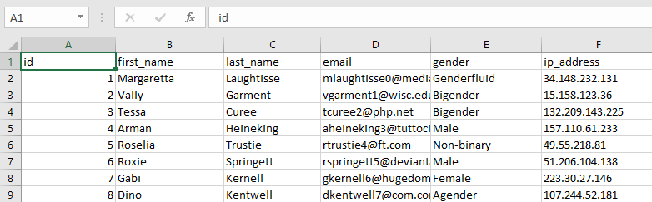
Snapshot of input data

Slide 12
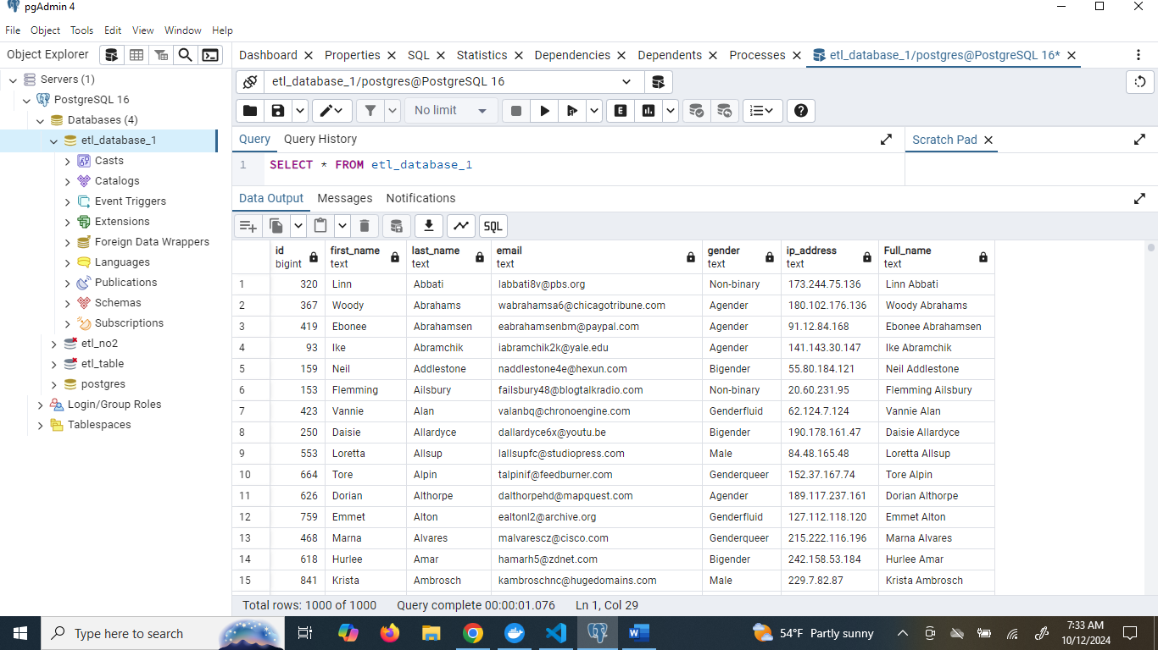
After ETL : pgAdmin UI

Slide 13
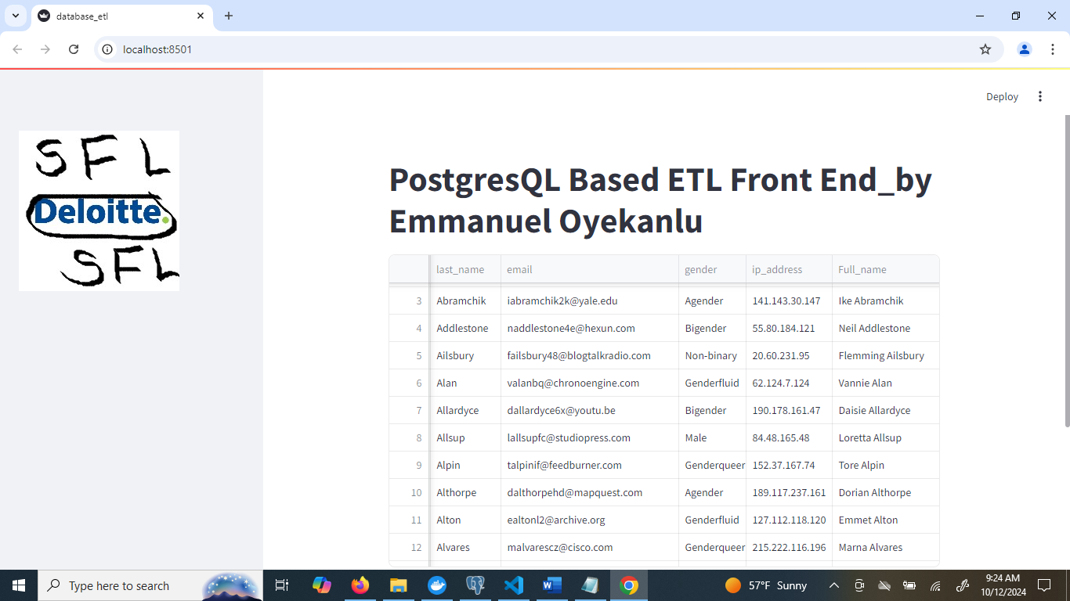

After ETL : Streamlit API
Apologies for the crudely designed DeloitteSFL logo

Slide 14
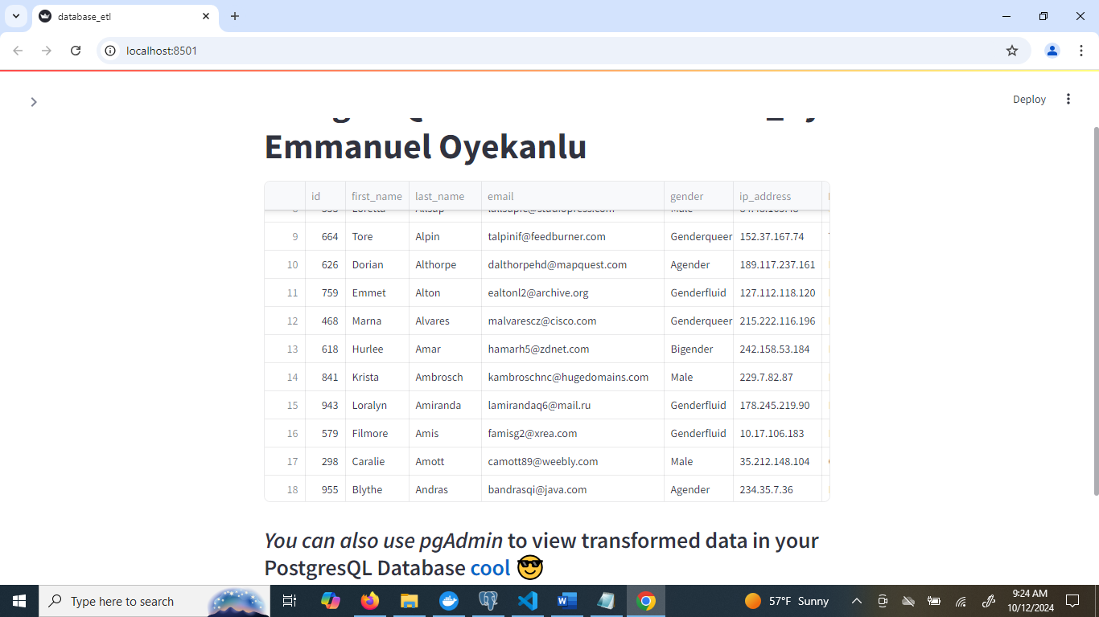
After ETL : Streamlit API

Slide 15
PostgreSQL Based Data ETL Solution on Docker with pgAdmin and Streamlit Frontend
Background
An Extraction, Transform and Loading (ETL) project that automates the ingestion of data from a provided CSV/xlsx file, transform the data and load the data into a PostgreSQL database.
Result
Loaded data can be viewed through using PostgreSQL’s pgAdmin user interface (UI).
Streamlit (front end) for user’s convenience.
Docker & virtual environment for reproducibility

Slide 16
Deep Learning Model Deployment on Docker with Flask API
Background
One of the major goals of training machine learning models is to solve real world problems, and this goal can only be accomplished when a trained model is deployed in productions and being actively used by consumers.
This projects shows how a deep learning model that has been trained and saved in a desired format (e.g. .keras, .h5, .hdf5 etc) can be deployed as an API endpoint, using the lightweight Flask API on Docker.

Slide 17
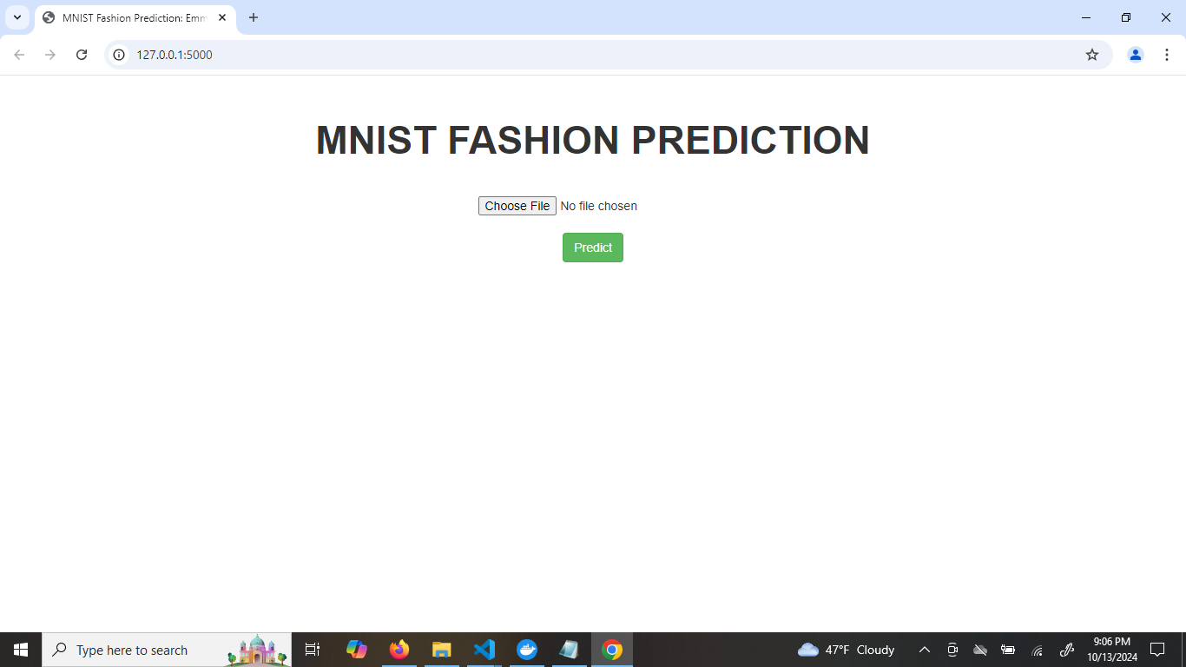
Some Results

Slide 18
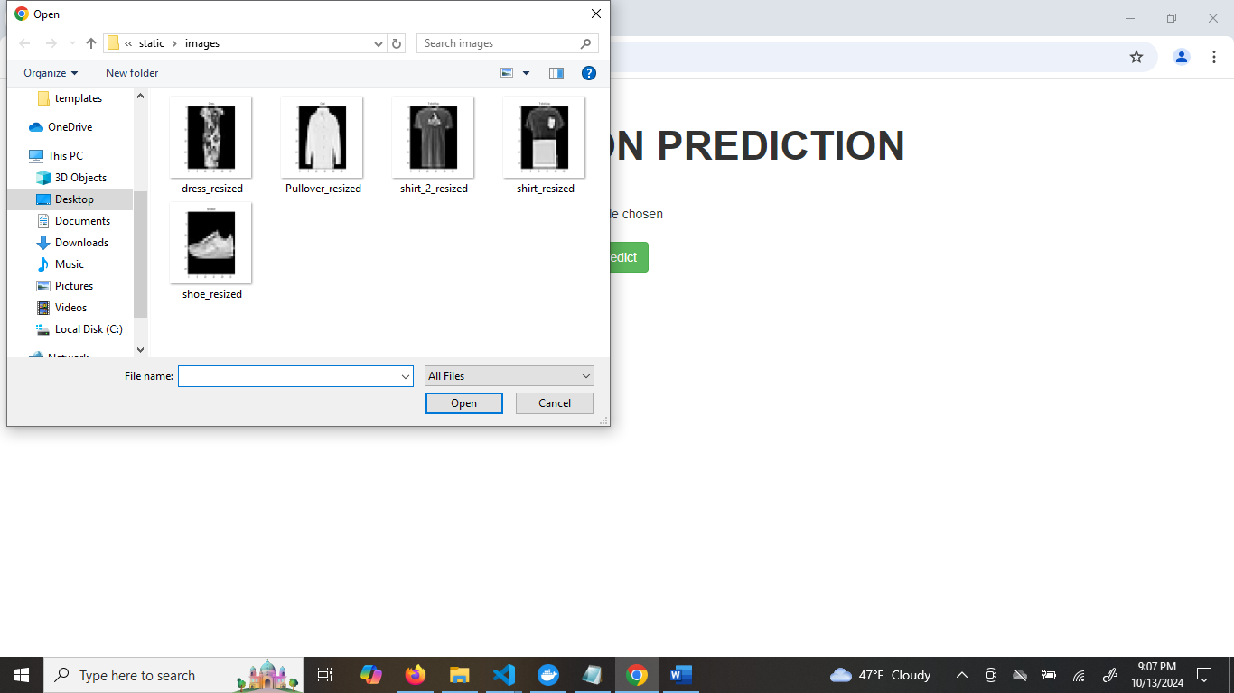
Some Results

Slide 19
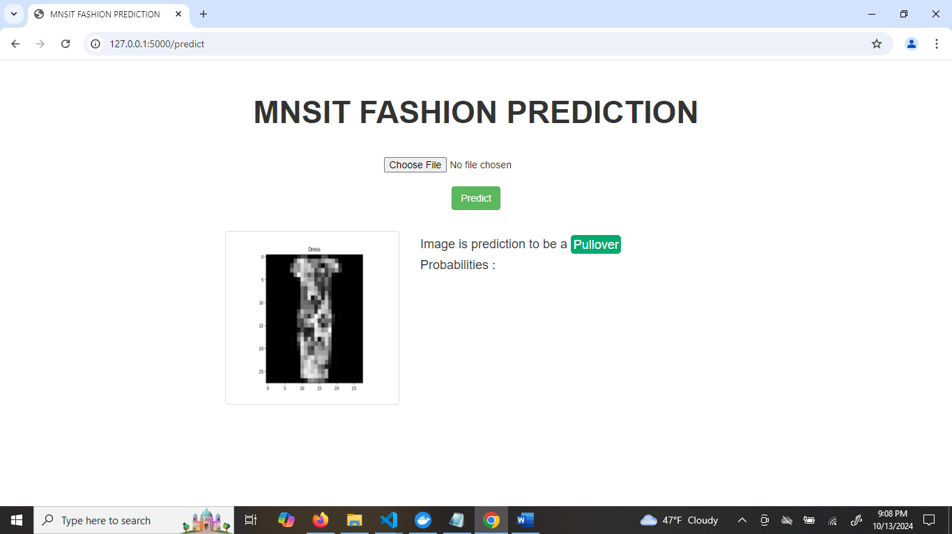
Some Results
Focus has been on deployment of the model as an end point API using Flask.
Prediction accuracy shall be improved in future iterations of the project.

Slide 20
Github Links
Problem 1
https://github.com/manuelbomi/Data-Engineering-ETL-Using-PostgreSQL-Docker-and-Streamlit-Front-End.git
Problem 2
https://github.com/manuelbomi/Deep-Learning-Image-Prediction-with-Flask-API-End-Point-on-Docker.git
Problem 3
https://github.com/manuelbomi/WorkPlan-for-ChemBERTa-NLP-Algorithm-Implementation-at-BPC.git

Slide 21
Questions/Suggestions
Thanks to the Deloitte SFL team for the opportunity

